Slide 1
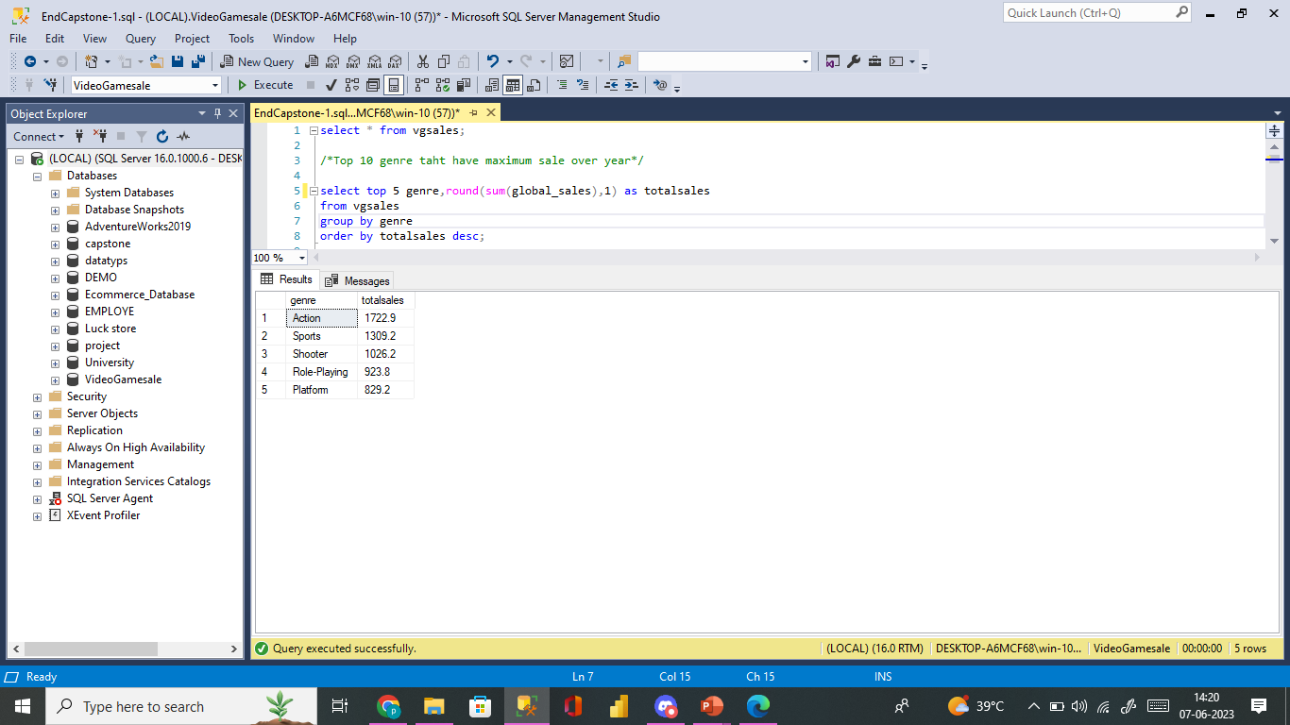
Visualization of Video game sales
VideoGame Sales Analysis Sql Report
Top 5 genre that have maximum sale over year
Top 5 Genre maximum sales over the year are Action,Sports,Shooter,Role-Playing,Platform.
Action game are most Popular one and gamers are more inclined are Action & Sports Genre.

Slide 2
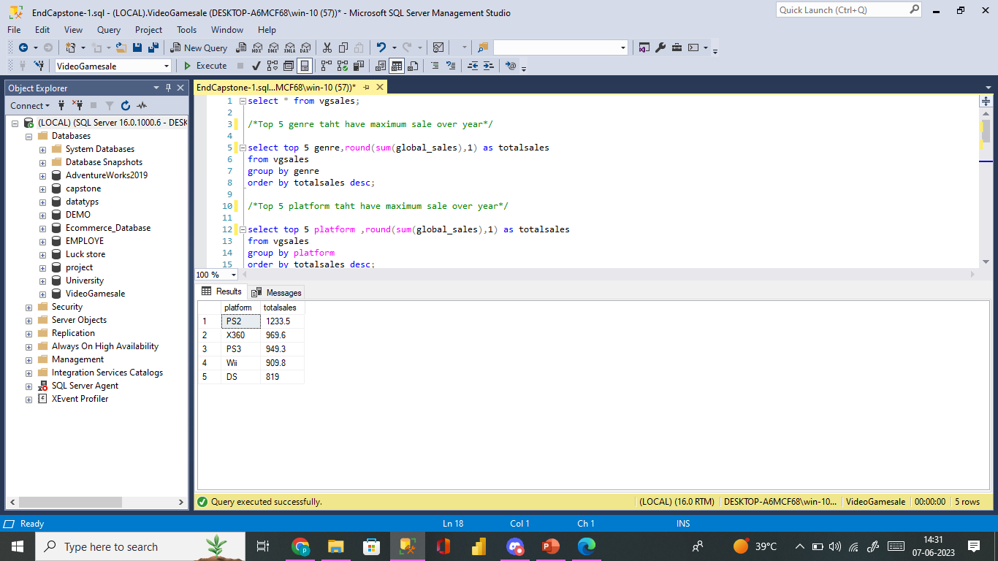
2. Top 5 platform taht have maximum sale over year
The top 5 Popular platform are PS2,X360,PS3,Wii,DS are most games produce these platform.
Most demanding platform PS2.
select top 5 platform ,round(sum(global_sales),1) as totalsales
from vgsales
group by platform
order by totalsales desc;

Slide 3
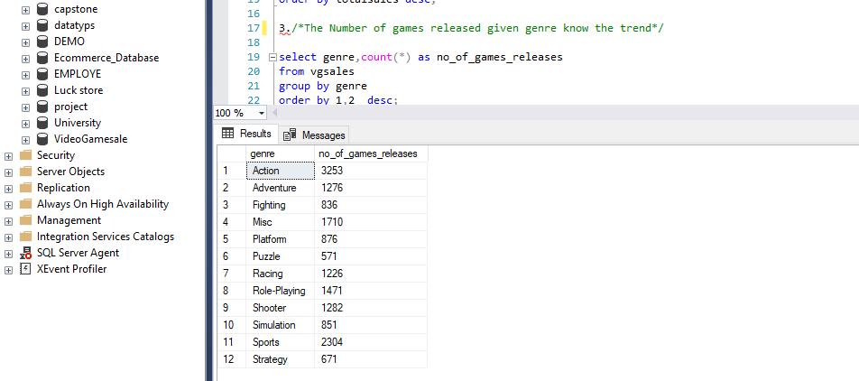
3. The Number of games released given genre know the trend
Over the year ,there has been 3370 games actions genre,2304 games released on sports,1710 games released on Misc,1471 games released on Role-playing,1282 games released on shooter.
Overral gaming industry more games on Actions,sports,Role-Playing genre.
select genre,count(*) as no_of_games_releases
from vgsales
group by genre
order by 1,2 desc;

Slide 4
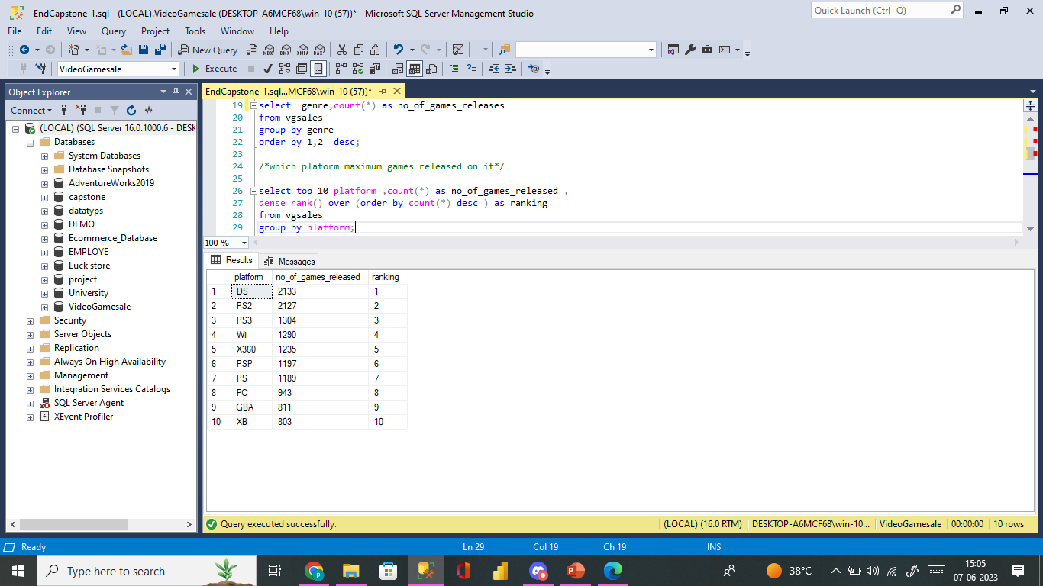
4. which platform maximum games released on it
Top 10 Platform
DS most number games released on platform and next almost equal to competition on PS2 are most popular console.
select top 10 platform ,count(*) as no_of_games_released ,
dense_rank() over (order by count(*) desc ) as ranking
from vgsales
group by platform

Slide 5
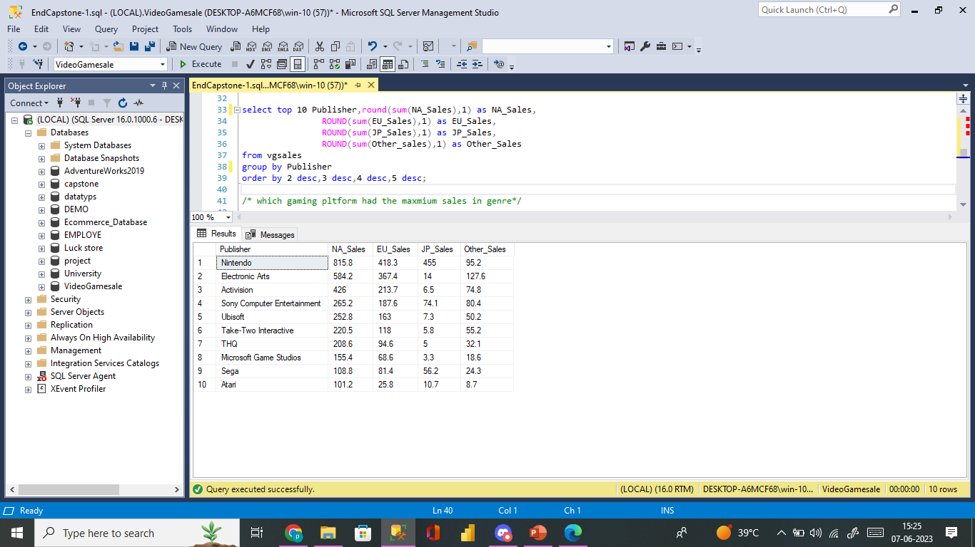
5. top 10 publisher whose sales highest as per region
North America has sales always is maximum
Top publisher are Nintendo,Electronic arts,Activation,sony.
Region like North-America,Europe has more business compared to Japan.
select top 10 Publisher,round(sum(NA_Sales),1) as NA_Sales,
ROUND(sum(EU_Sales),1) as EU_Sales,
ROUND(sum(JP_Sales),1) as JP_Sales,
ROUND(sum(Other_sales),1) as Other_Sales
from vgsales
group by Publisher
order by 2 desc,3 desc,4 desc,5 desc;

Slide 6
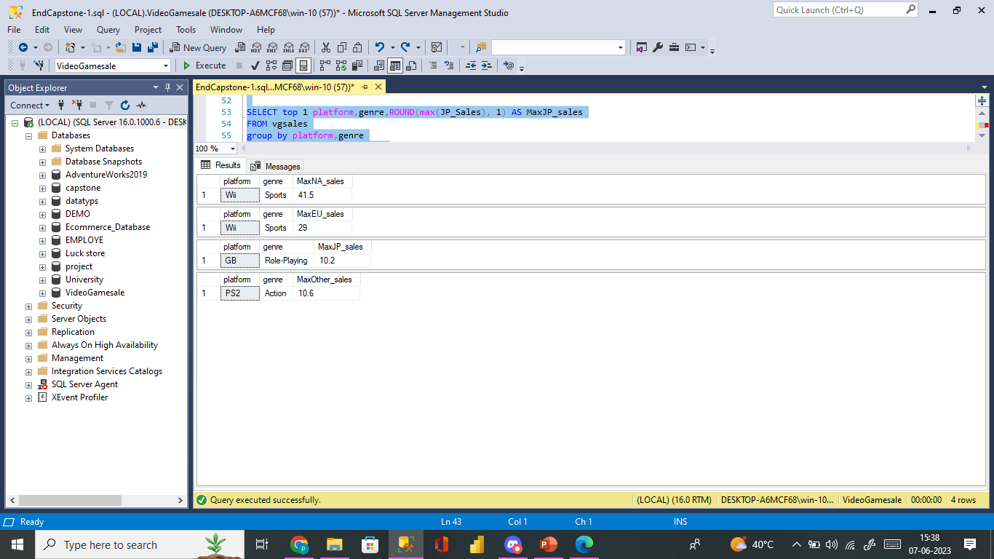
6. which gaming platform had the maximum sales in genre
Maximum selling games compare all region sales over the year observe maximum sales on Wii & sports genre.
SELECT top 1 platform,genre,ROUND(max(NA_Sales), 1) AS MaxNA_sales
FROM vgsales
group by platform,genre
order by MaxNA_sales desc;
SELECT top 1 platform,genre,ROUND(max(EU_Sales), 1) AS MaxEU_sales
FROM vgsales
group by platform,genre
order by MaxEU_sales desc;

